Slide 1


Emotion Phenomenology and Physiology Modeling Coopetition

Slide 2
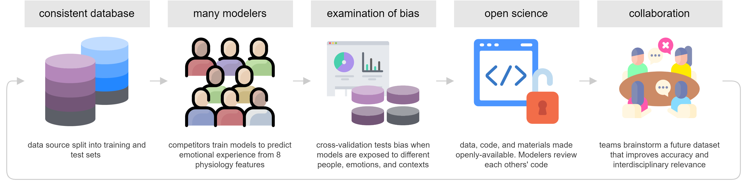
Emotion Physiology and Experience Competition (EPiC)

Slide 3




Slide 4






